Slide 1
PREVENTION OF ALLOY CORROSION BY CO₂ GAS
David Young
Lesson 2 Class 1
School of Materials Science & Engineering
University of New South Wales
Sydney, Australia

Slide 2
Fe-Cr Alloys
Cr-rich carbides precipitate internally
Reduces alloy N_{Cr}
In lower Cr alloys (eg P91) not enough left to grow protective scale
SOLUTION:
BUT:

Slide 3
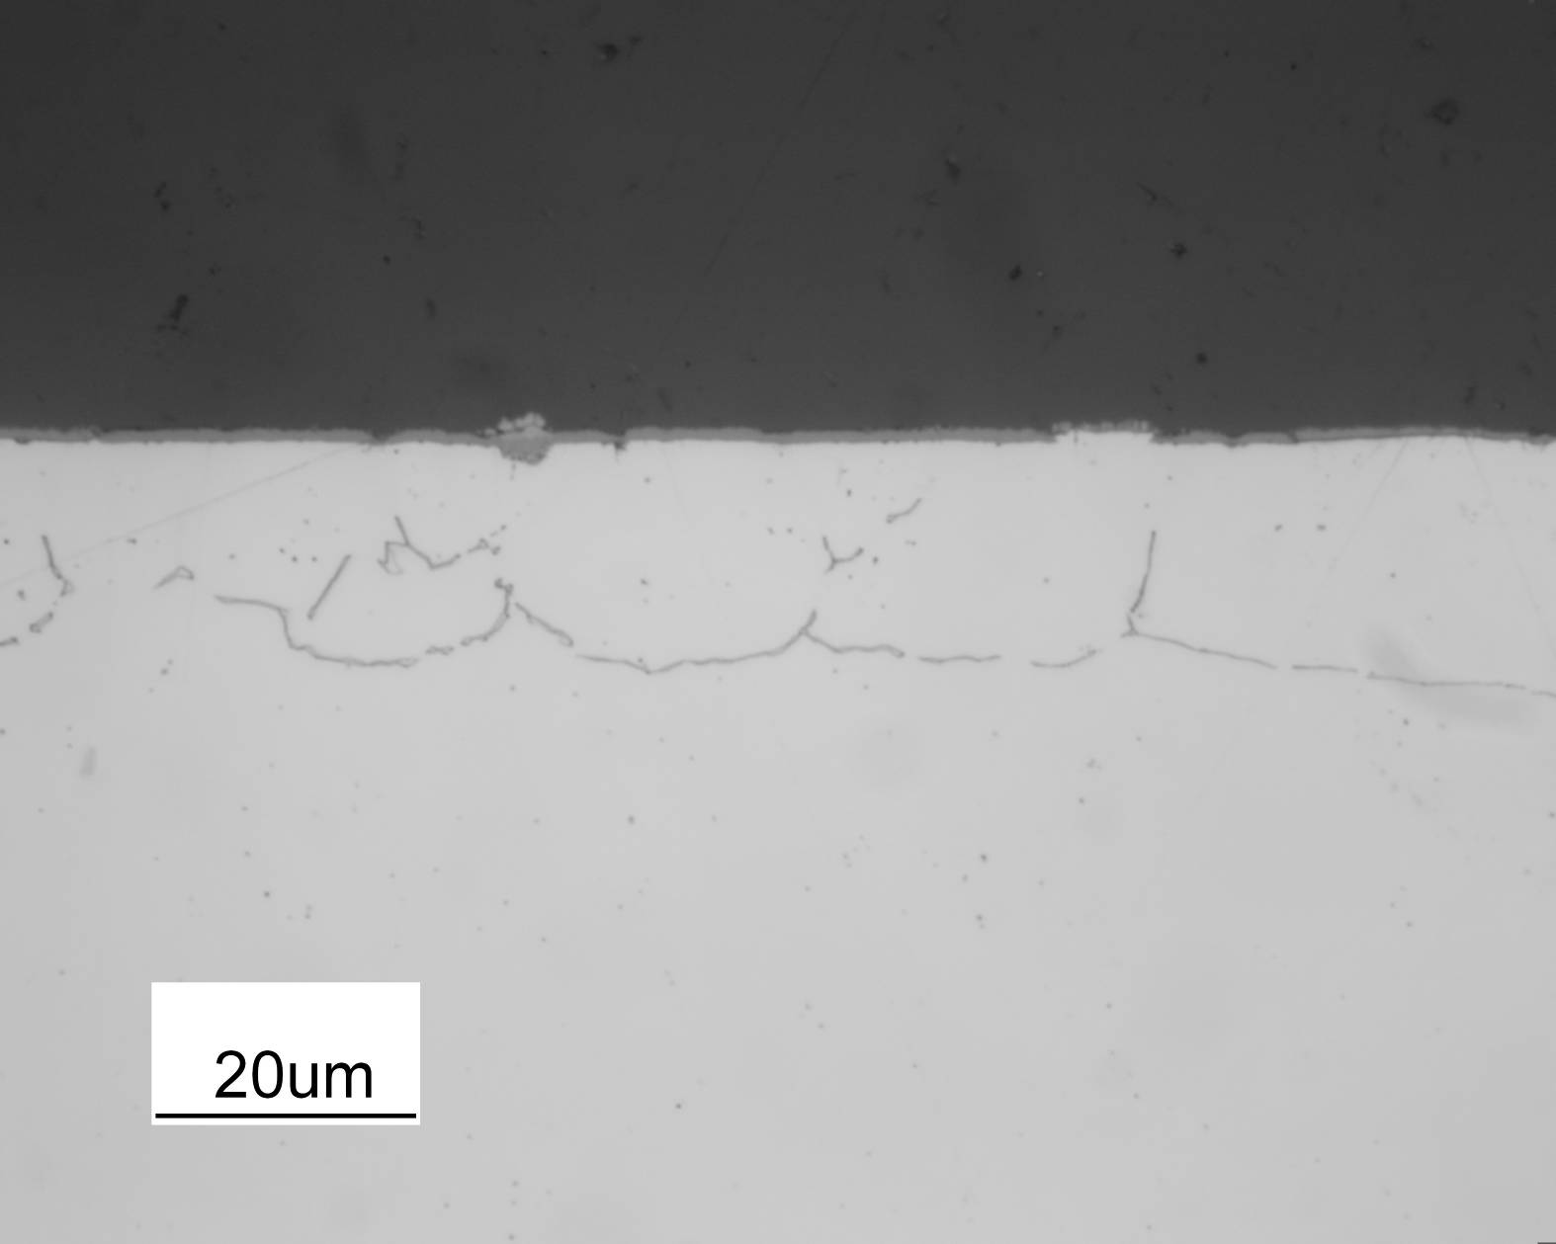
High Cr Alloys also Carburise in CO₂
Cr₂O₃
UNDESIRABLE:
Changes to subsurface…
carbide
Fe-20Cr, 650ºC

Slide 4
Possible Solutions
Remember the mechanism
Gas
CO₂
Cr₂O₃
C:
C
Alloy

Slide 5
Possible Solutions
Remember the mechanism
Interfere with these steps
Gas-scale interface:
Oxide grain boundaries
Scale-alloy interface
Alloy to lower C entry
Gas
CO₂
Cr₂O₃
C
Alloy

Slide 6
Possible Solutions
Remember the mechanism
Interfere with these steps
Gas-scale interface: block CO₂ access to Cr₂O₃
(a) Preferential adsorption
Gas
CO₂
Cr₂O₃
C
Alloy

Slide 7
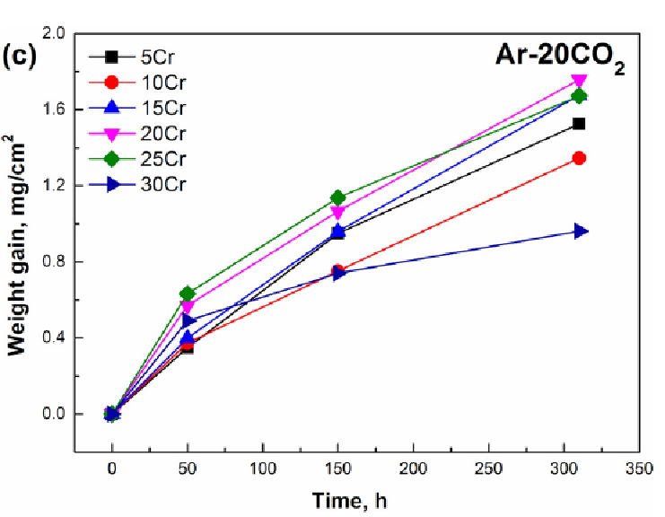
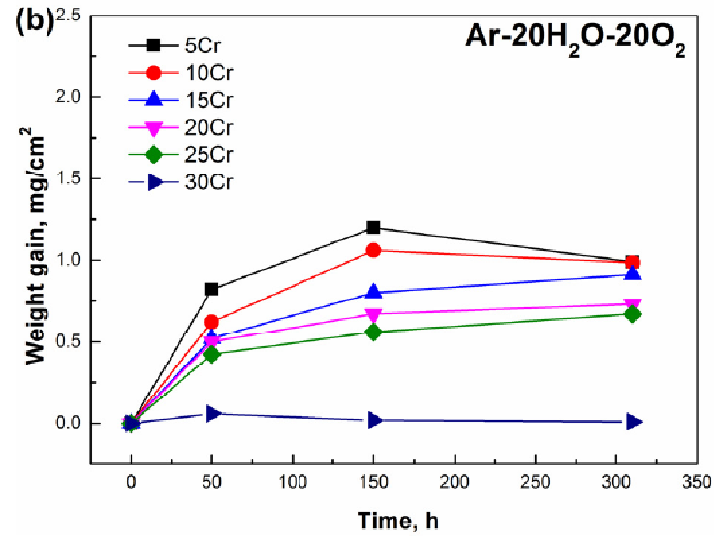
Preferential Adsorption of Other Gas Species: O
Ni-Cr alloys at 650ºC

Slide 8
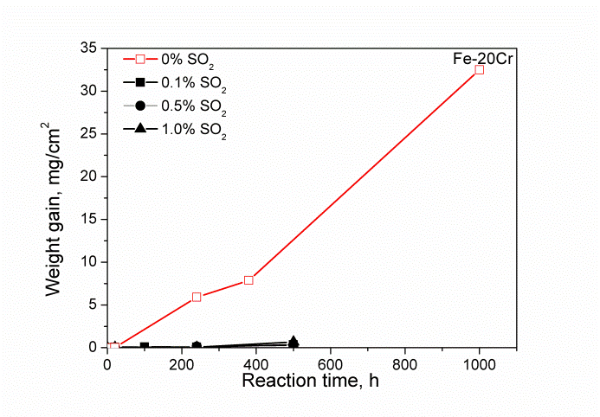
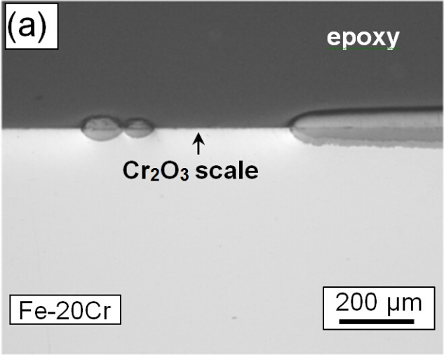
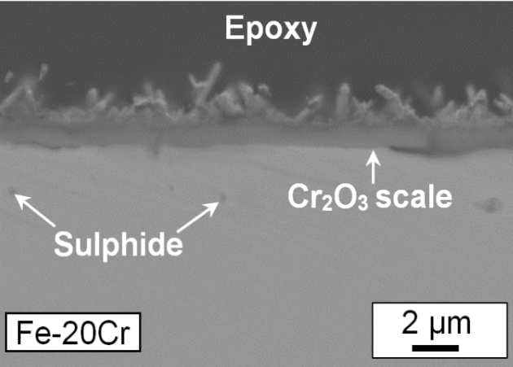
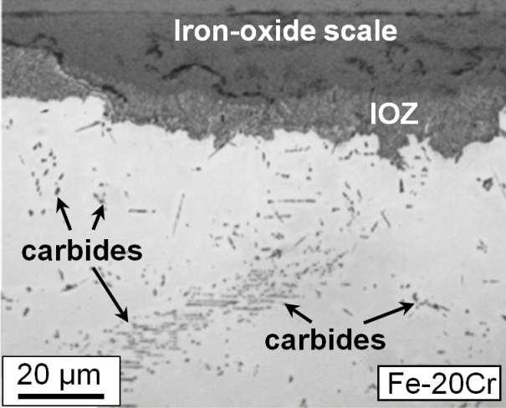
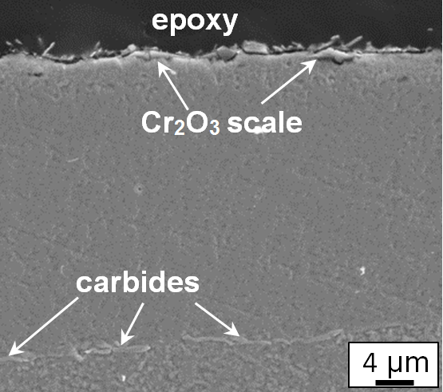
Effect of SO₂ in CO₂-H₂O gas Fe-20Cr, 650ºC
S-free gas
S-containing gas
Breakaway oxidation
Extensive carburisation under iron-rich oxide scale
Protective oxidation
Intergranular carbide
Intergranular sulphide
25/5/2015

Slide 9
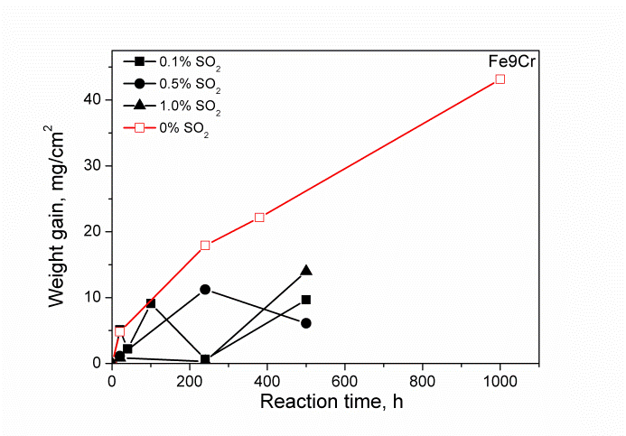
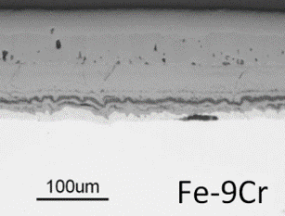
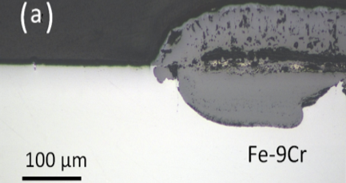
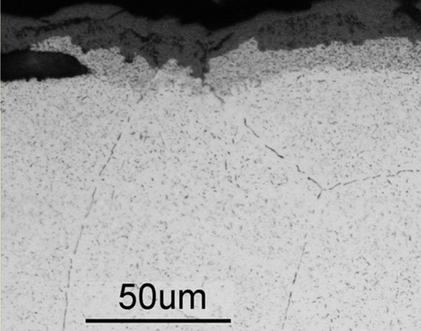
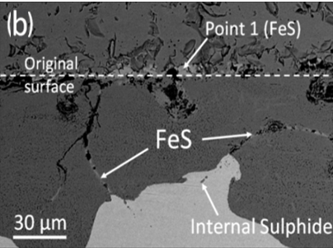
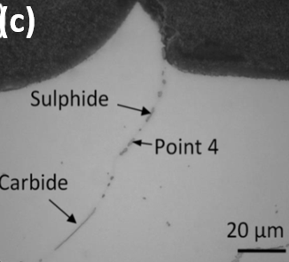
Effect of SO₂ in CO₂-H₂O gas Fe-9Cr, 650ºC
S-free gas
S-containing gas
Breakaway oxidation
Extensive carburisation
Partially protective
Only intergranular carbide
Intergranular sulphide
(a)
Iron-oxide scale
(b)
Iron-oxide scale
IOZ
carbide

Slide 10
Alloy Design
Gas composition control may be impossible (process reasons)
Examine ways of designing alloys to perform better

Slide 11
Possible Solutions
Remember the mechanism
Interfere with these steps
Gas-scale interface: block CO₂ access to Cr₂O₃
Preferential adsorption
Alloy to form another oxide layer at surface
Gas
CO₂
Cr₂O₃
C
Alloy

Slide 12
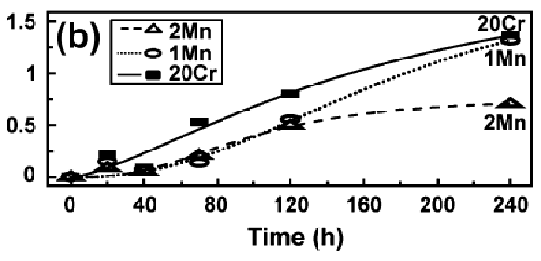
Fe-Cr-Mn Alloys
ΔW/A mg.cm⁻²
Ar-20CO₂, T=818ºC
Mn Effect
Slows corrosion by factor 2X

Slide 13
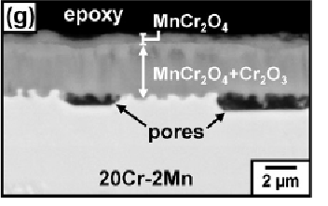
Fe-Cr-Mn Alloys
Ar-20CO₂, T=818ºC
ΔW/A mg.cm⁻²
Mn Effect
Slows corrosion by factor 2X
No carburisation
Surface of scale is MnCr₂O₄

Slide 14
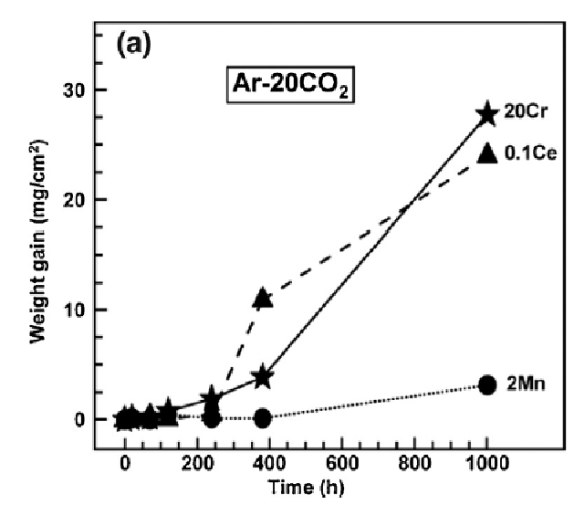
Fe-Cr-Mn Alloys, 650ºC, Ar-20CO₂
Mn reduces corrosion rate by order of magnitude

Slide 15
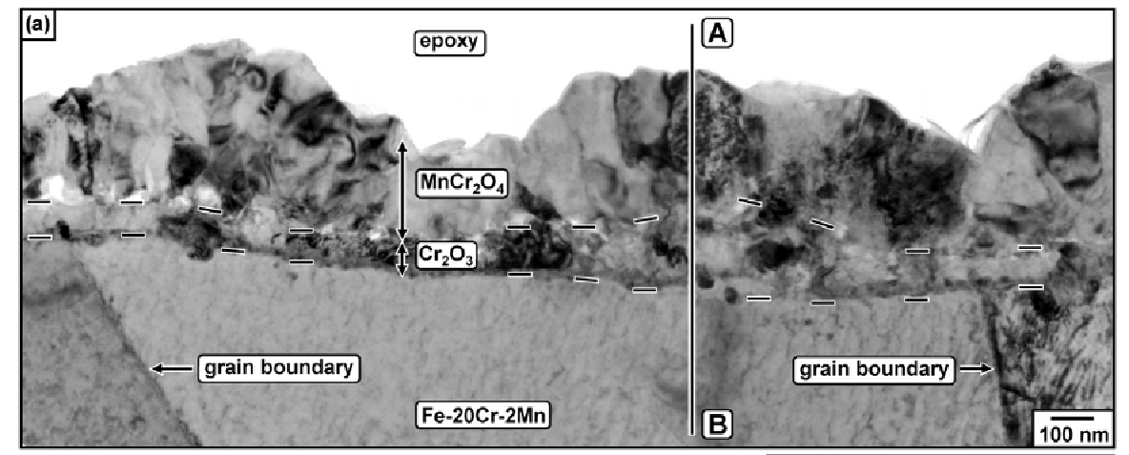
Fe-Cr-Mn Alloys, 650ºC, Ar-20CO₂
TEM
No internal carbides
Mn reduces corrosion rate by order of magnitude
Mn diffuses through chromia, grows outer spinel layer
Spinel blocks C entry

Slide 16
Possible Solutions
Remember the mechanism
Interfere with these steps
Gas-scale interface:
Oxide grain boundaries
Gas
CO₂
Cr₂O₃
C
Alloy

Slide 17
Possible Solutions
Remember the mechanism
Interfere with these steps
Gas-scale interface:
Oxide grain boundaries
Enlarge grains?.....
Block grain boundaries…...
Gas
CO₂
Cr₂O₃
C
Alloy

Slide 18
SOLUTIONS
Prevent C passage of g.b’s
Gas
Cr₂O₃
Alloy
Grain boundary engineering

Slide 19
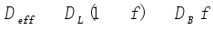
Size of Effect?
Effective diffusion coefficient:
weighted sum of lattice and grain boundary contributions

Slide 20
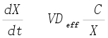
Size of Effect?
Effective diffusion coefficient:
weighted sum of lattice and grain boundary contributions
Metal
Gas
X

Slide 21
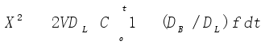
Size of Effect?
Effective diffusion coefficient:
weighted sum of lattice and grain boundary contributions
Metal
Gas
Integrate:
X

Slide 22
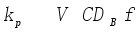
Size of Effect?
Effective diffusion coefficient:
weighted sum of lattice and grain boundary contributions
Metal
Gas
Integrate:
X
For D_{B}>>D_{L},
f constant

Slide 23
Assume Cubic Oxide Grains
L
Grain boundary width d

Slide 24
Assume Cubic Oxide Grains
L
Grain boundary width d
Area of grain boundary per grain
(0.5dL) 4
Area of grain = L²
Grain boundary fraction f =2d/L

Slide 25
Size of Effect?
Effective diffusion coefficient:
weighted sum of lattice and grain boundary contributions
Metal
Gas
Integrate:
X
For D_{B}>>D_{L},
f constant
k_{p} = 2dVΔCD_{B}/L

Slide 26
Possible Solutions
Remember the mechanism
Interfere with these steps
Gas-scale interface:
Oxide grain boundaries
Scale-alloy interface
Gas
CO₂
Cr₂O₃
C
Alloy

Slide 27
Possible Solutions
Remember the mechanism
Interfere with these steps
Gas-scale interface:
Oxide grain boundaries
Scale-alloy interface
Alloy to grow a different (more protective) layer at scale-alloy interface
Gas
CO₂
Cr₂O₃
C
Alloy

Slide 28
Alloy for Growth of Oxide under Cr₂O₃
REQUIREMENTS
New oxide must be more stable than Cr₂O₃
New alloy component must be able to diffuse to surface

Slide 29
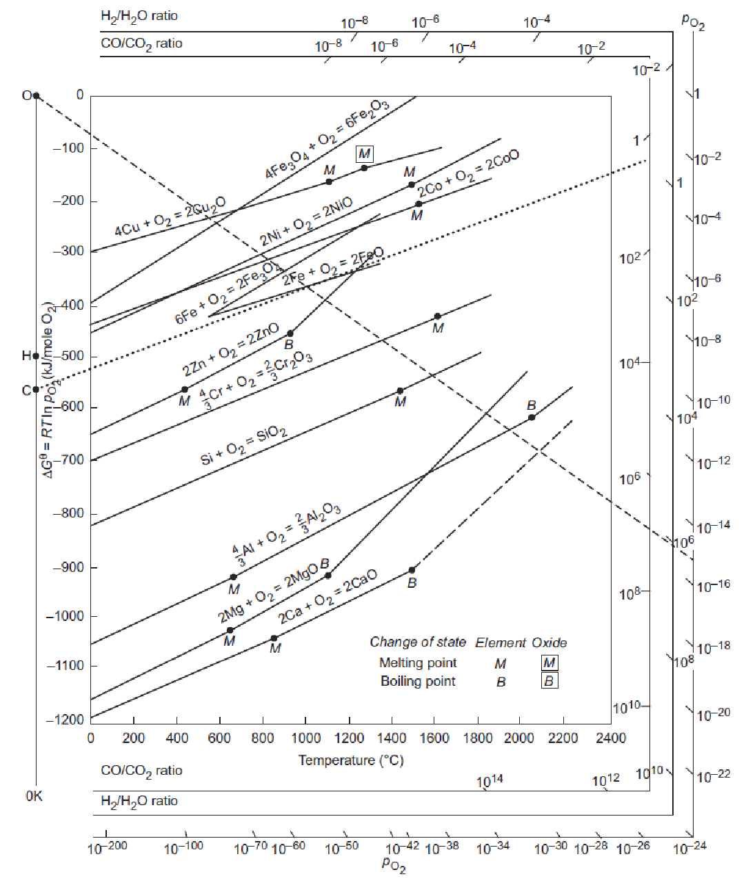
Cr oxidation

Slide 30
Si as an Alloy Addition?
Silica more stable than Chromia: therefore stable under Cr₂O₃ scale OK
Must ensure that it oxidises externally, not internally
Need continuous layer of silica

Slide 31
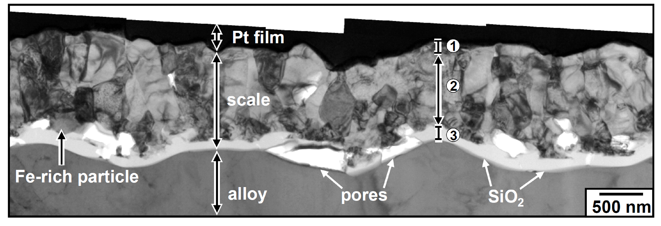
BARRIER LAYER SiO₂
TEM-BF: Fe-20Cr-0.2Si after reaction for 240 h
No internal carburisation

Slide 32
Si effect on Fe-20Cr: Mechanism
Cr₂O₃
p(O₂) very low
Cr₂O₃
Alloy
Alloy
J_{O} negligible
J_{Si} significant
Chromia promotes external silica layer growth

Slide 33
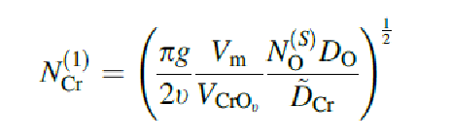
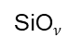
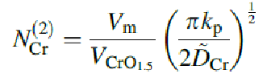

How Much Si?
For external and not internal SiO₂
Si
To maintain single-phase layer
Si

Slide 34
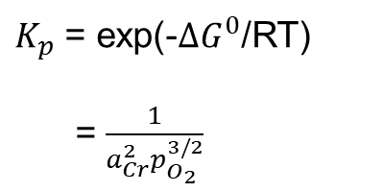
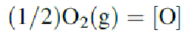
For External SiO₂
Need Oxygen solubility in alloy
Cr₂O₃
p(O₂) very low
2Cr + 3/2O₂ = Cr₂O₃
Alloy

Slide 35
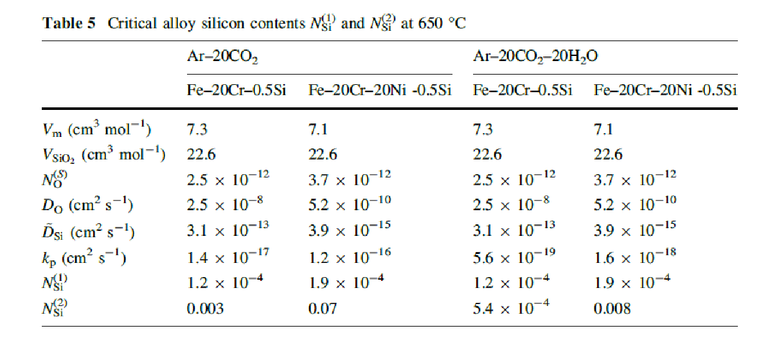
Calculation Results
Avoiding internal oxidation of Si easy
Continuous SiO₂ layer difficult, particularly for austenitics

Slide 36
Possible Solutions
Remember the mechanism
Interfere with these steps
Gas-scale interface:
Oxide grain boundaries
Scale-alloy interface
Alloy to lower C entry
Gas
CO₂
Cr₂O₃
C
Alloy

Slide 37
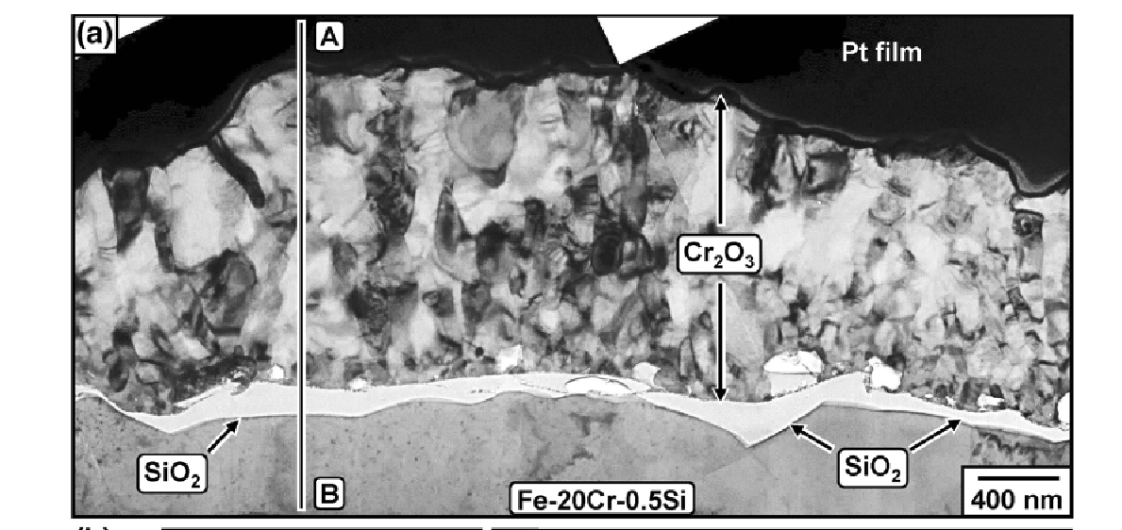
Fe-20Cr-0.5Si, 650ºC, Ar-20CO₂
TEM bright field

Slide 38
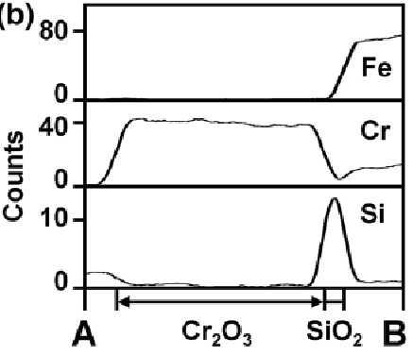
Fe-20Cr-0.5Si, 650ºC, Ar-20CO₂
TEM bright field
EDS line scan

Slide 39
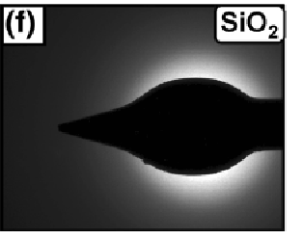
Fe-20Cr-0.5Si, 650ºC, Ar-20CO₂
EDS line scan
TEM bright field
SAD SiO₂ layer

Slide 40
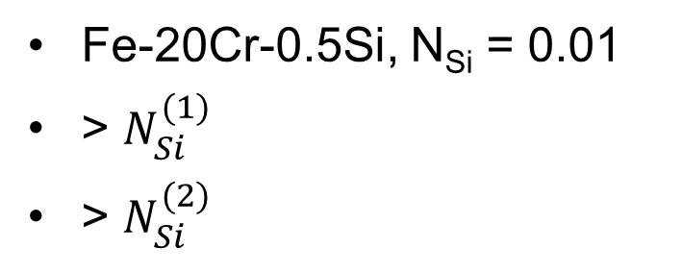
Ferritic Alloy Design Succeeds

Slide 41
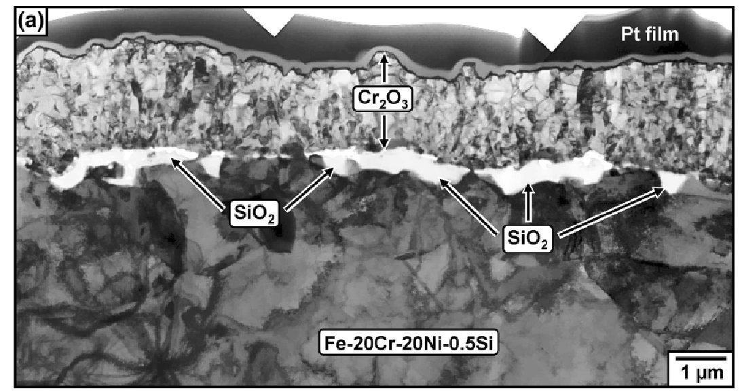
Fe-20Ni-20Cr-0.5Si, 650ºC, Ar-20CO₂

Slide 42
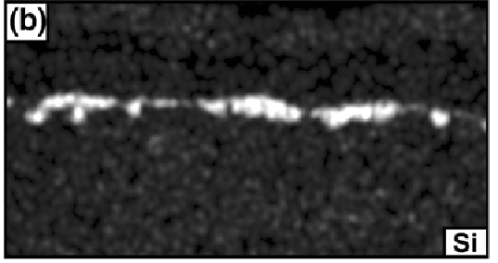
Fe-20Ni-20Cr-0.5Si, 650ºC, Ar-20CO₂
EDS Si map

Slide 43
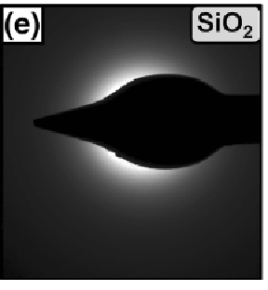
Fe-20Ni-20Cr-0.5Si, 650ºC, Ar-20CO₂
EDS Si map
SAD SiO₂ layer

Slide 44
Fe-20Ni-20Cr-0.5Si, 650ºC, Ar-20CO₂
EDS Si map
SAD SiO₂ layer

Slide 45
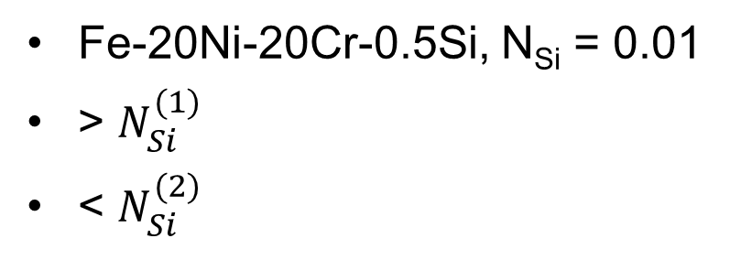
Austenitic Alloy Design almost Succeeds
Silica forms externally, but not continuous

Slide 46
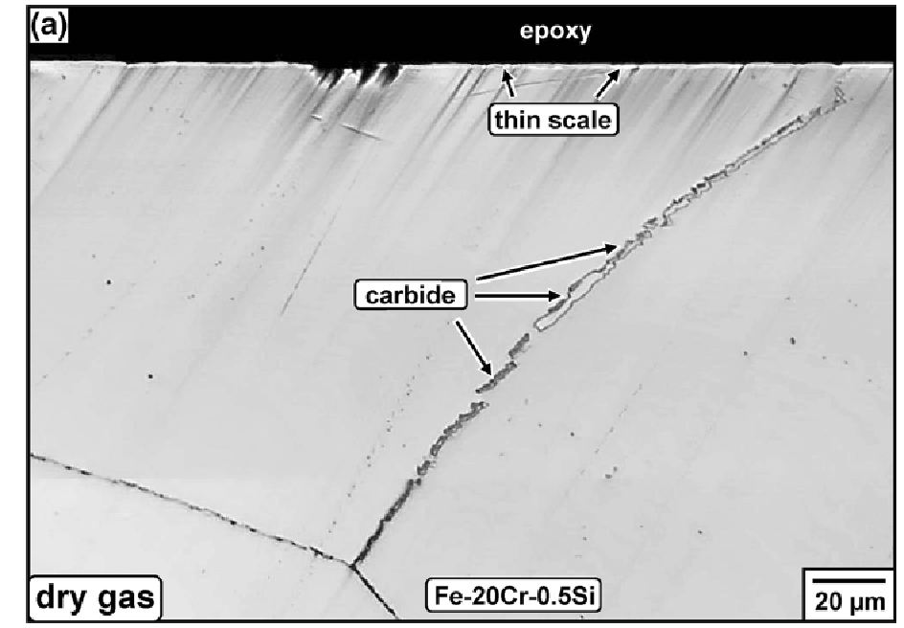
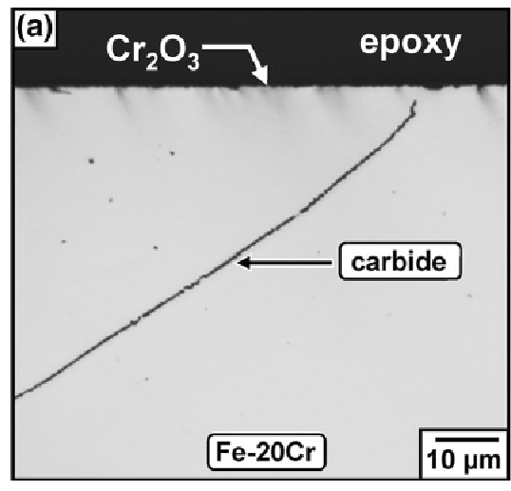
Effect of SiO₂ Layer on Carburisation
Ar-20CO₂, T = 650ºC, 1000 h

Slide 47
Effect of SiO₂ Layer on Carburisation
Fe-20Cr: carburises from very short times
Fe-20Cr-0.5Si: onset of carburisation delayed hundreds of hours
Fe-20N-20Cr (austenitic) slower carburisation than Fe-20Cr
Ni-20Cr: carburises still more slowly

Slide 48
Possible Solutions
Remember the mechanism
Interfere with these steps
Gas-scale interface:
Oxide grain boundaries
Scale-alloy interface
Alloy to lower C entry
Gas
CO₂
Cr₂O₃
C
Alloy

Slide 49
Optimise alloy for carburisation resistance?
Learnt in first class: not very successful for steels
Ni-base alloys much more resistant to carburisation
C permeability lower

Slide 50
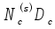
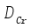
Optimise alloy for carburisation resistance?
Learnt in first class: not very successful for steels
Ni-base alloys much more resistant to carburisation
C permeability lower
Alloy | T/C
γ-Fe | 900 | 4.3x10⁻⁹ | 4.4x10⁻¹³
 | 1000 | 1.4x10⁻⁸ | 3.7x10⁻¹²
 | 1100 | 5.5x10⁻⁸ | 2.3x10⁻¹¹
Ni | 900 | 7.9x10⁻¹⁰ | 8.0x10⁻¹³
 | 1000 | 3.6x10⁻⁹ | 7.2x10⁻¹²
 | 1100 | 1.4x10⁻⁸ | 4.7x10⁻¹¹

Slide 51
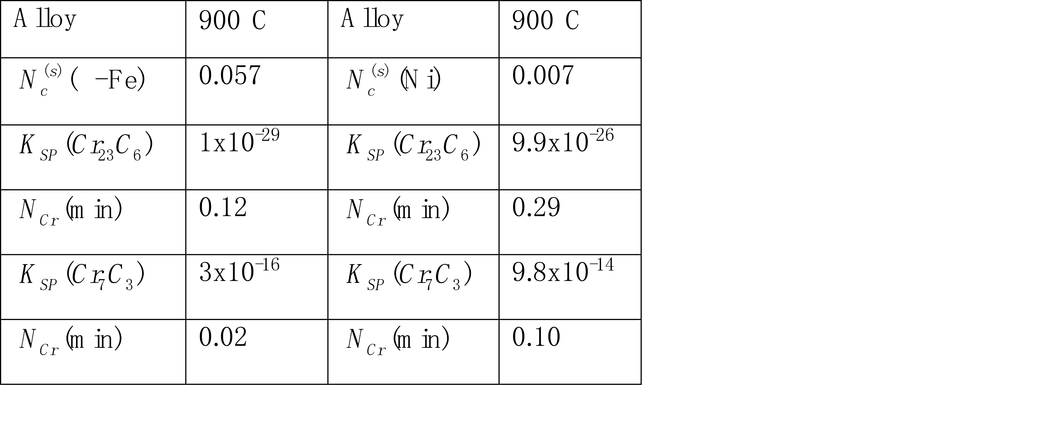
Optimise alloy for carburisation resistance?
Learnt in first class: not very successful for steels
Ni-base alloys much more resistant to carburisation
C permeability lower in Ni
Carbides less stable in Ni

Slide 52
Alloy Design to Resist CO₂
Fe- or Ni-base
Level of Cr
Other alloy components
Surface treatment

